Slide 1
Slum
Poor Urban Settlement
Squatter Settlement
Shanty Town
Third World Ghetto
Third World Settlement
Poor Housing
Third World Housing

Slide 2
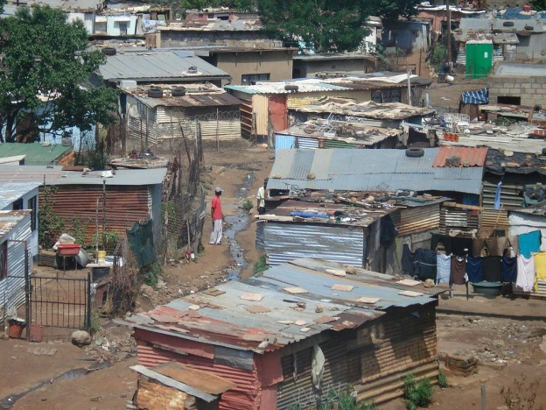
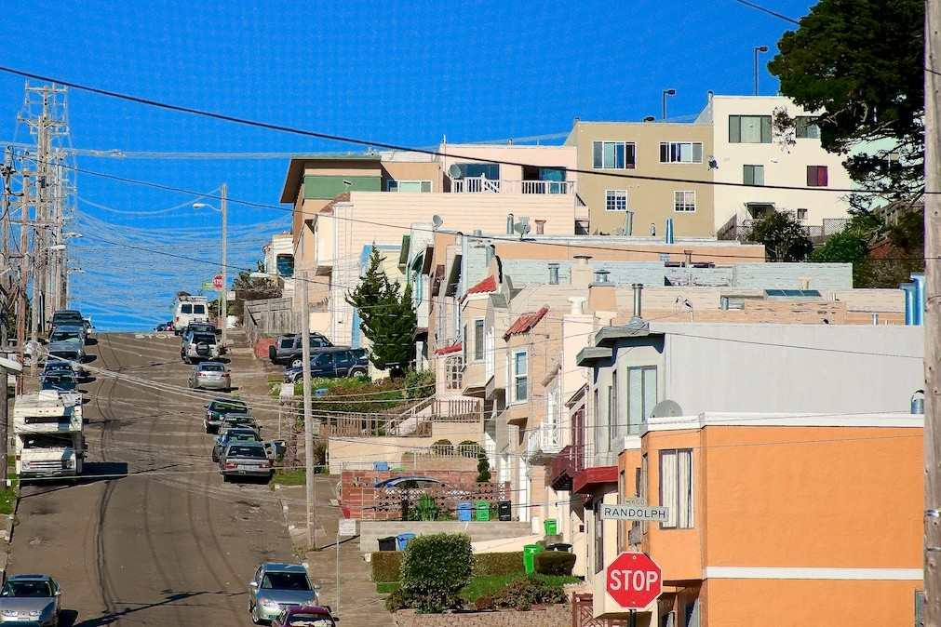
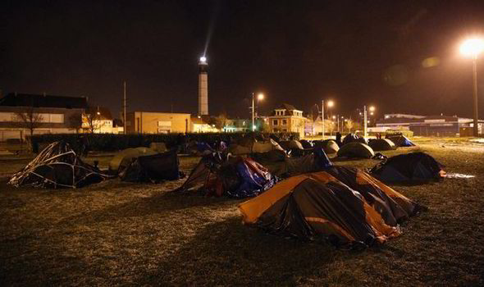
Settlement
Organic
Planned
Spontaneous

Slide 3
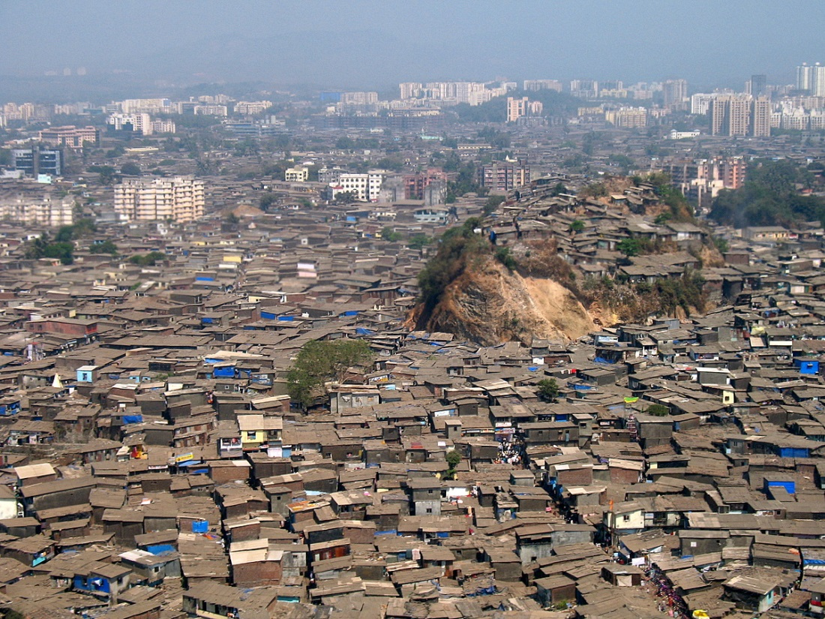
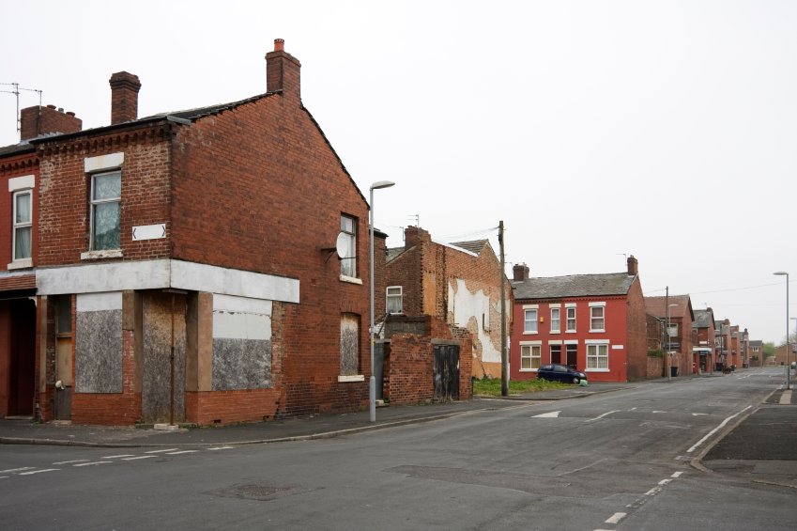
Density
Overcrowded
Spread Out

Slide 4
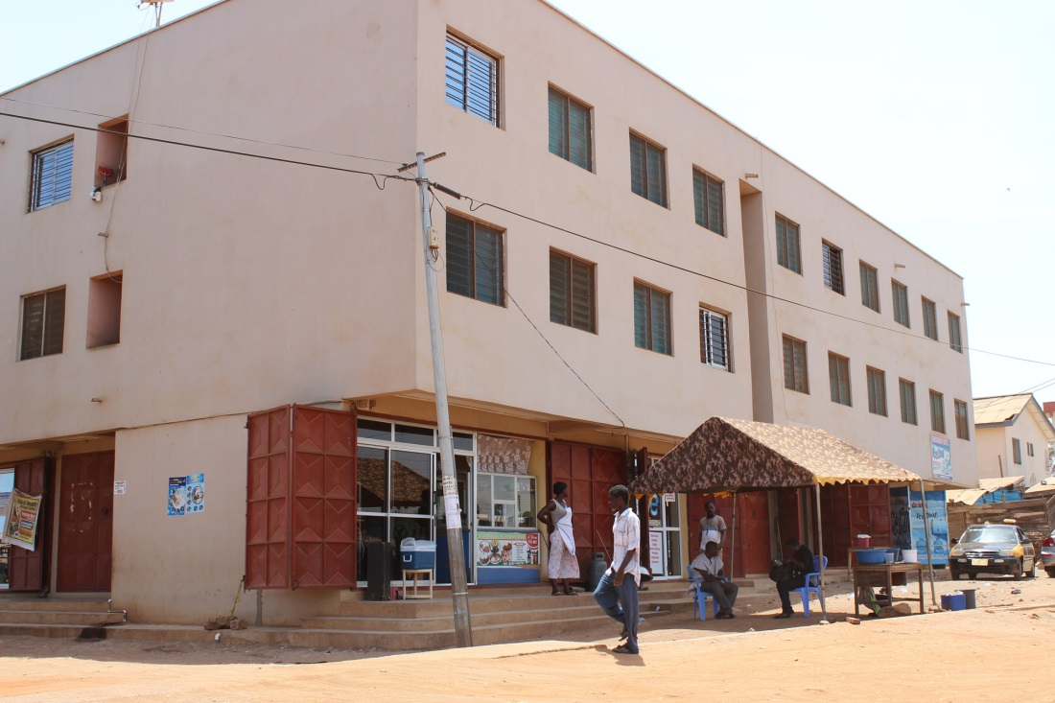
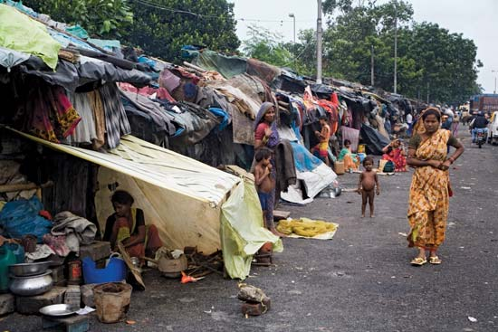
Building Material
Pucca
(sturdy)
Kucha
(un-sturdy)

Slide 5
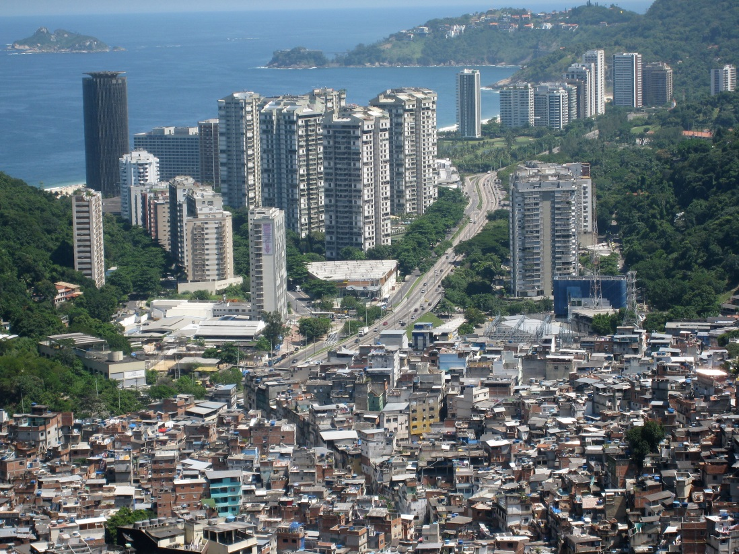
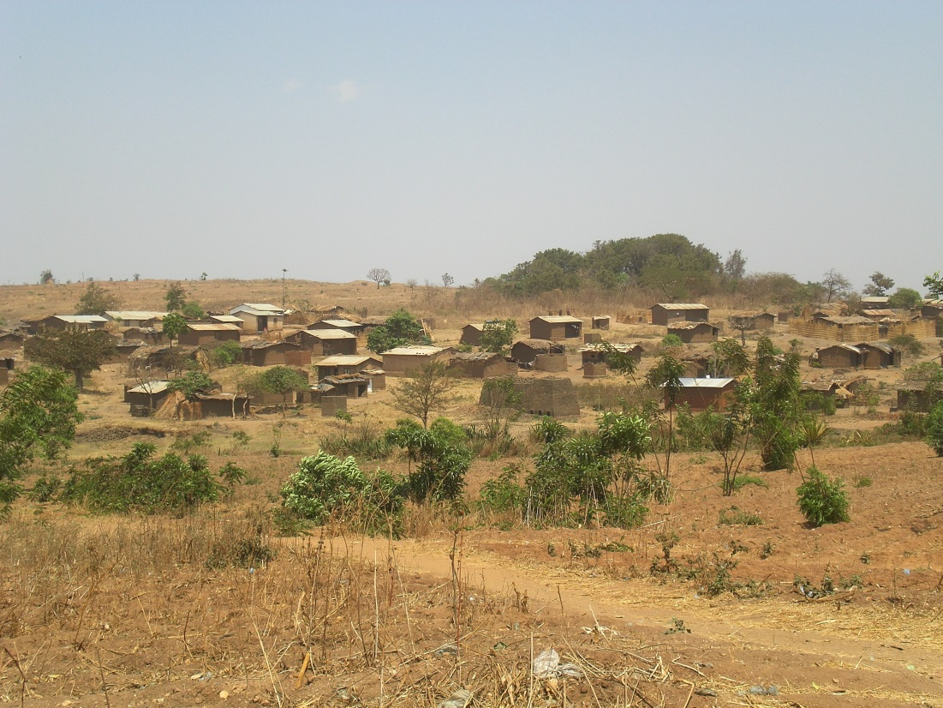
Rural vs Urban
Rural
Urban

Slide 6
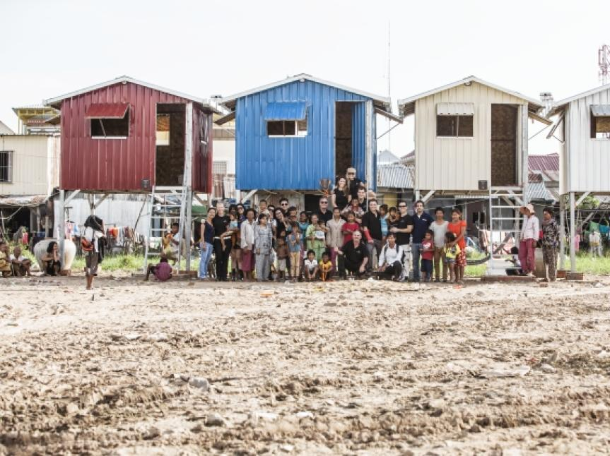
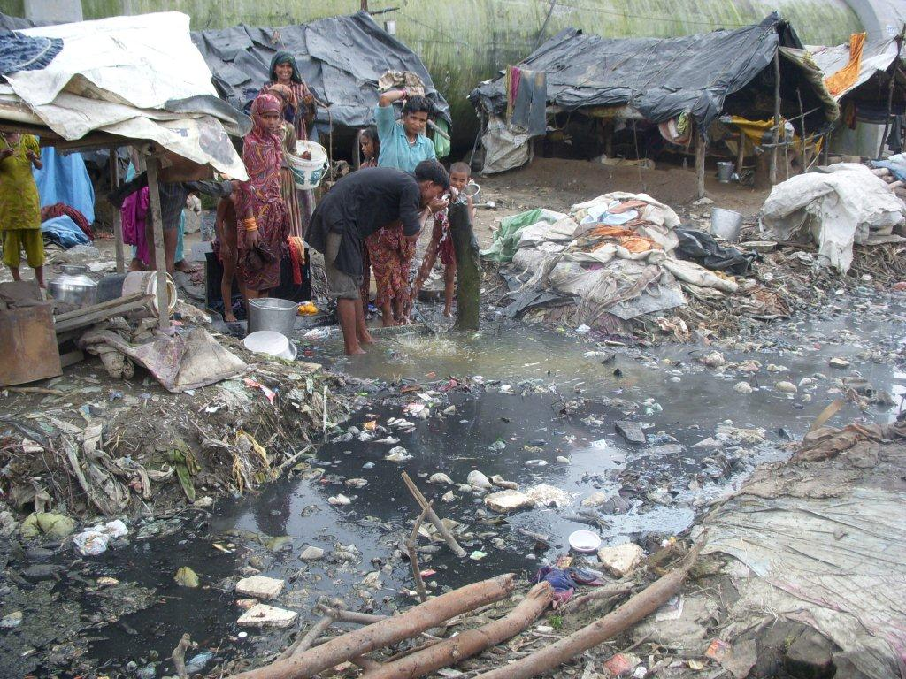
Cleanliness
Clean
Dirty

Slide 7
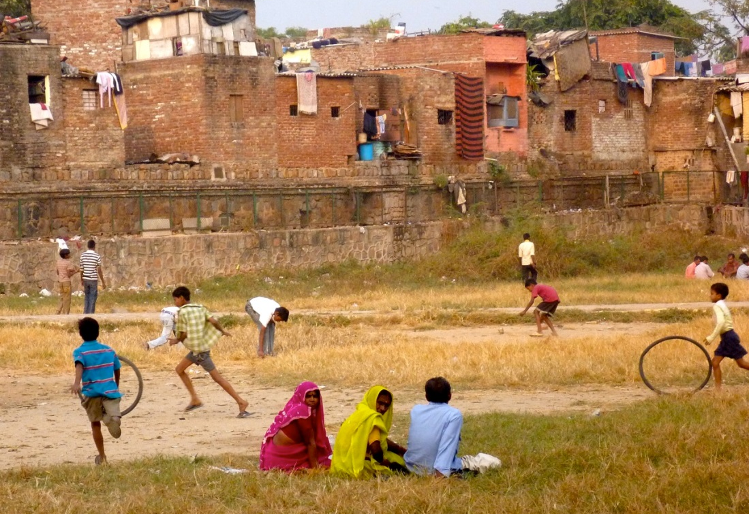
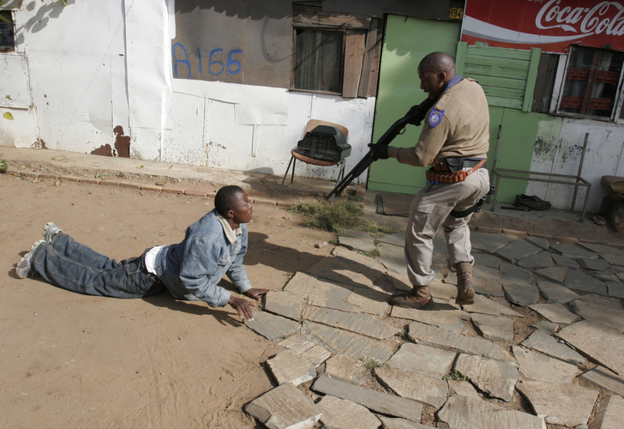
Safety
Safe
Unsafe

